Slide 1
BI 410/510: Data analysis and visualization
Lauren Hallett

Slide 2
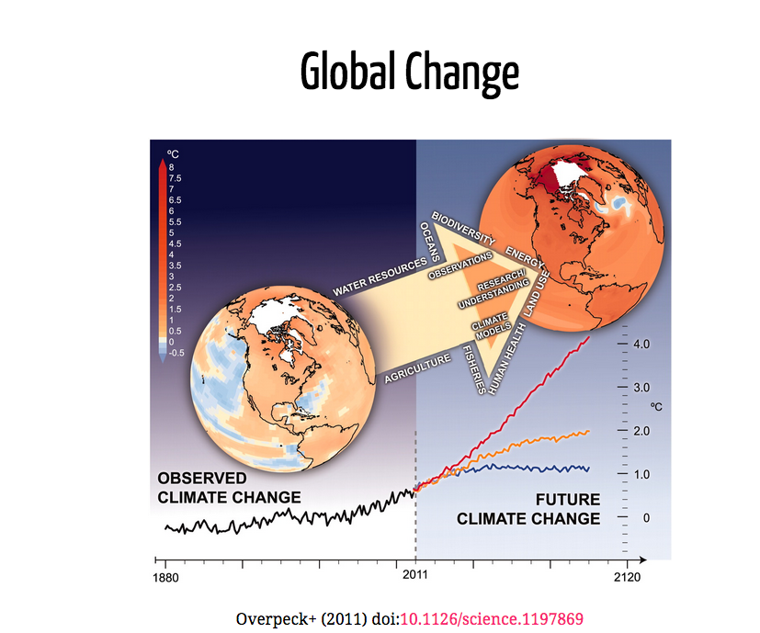

Slide 3
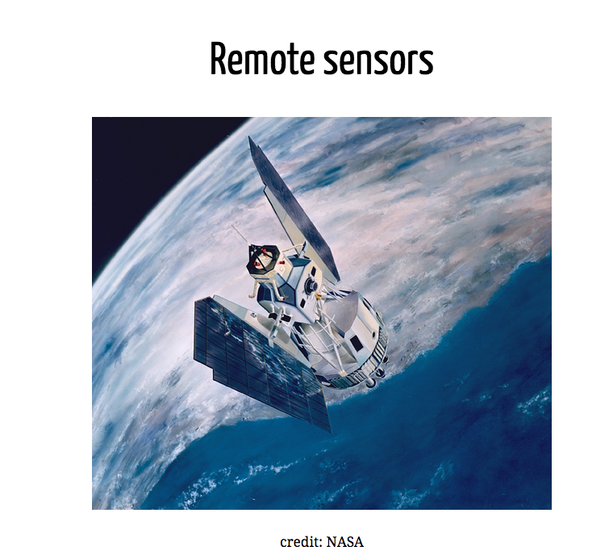

Slide 4
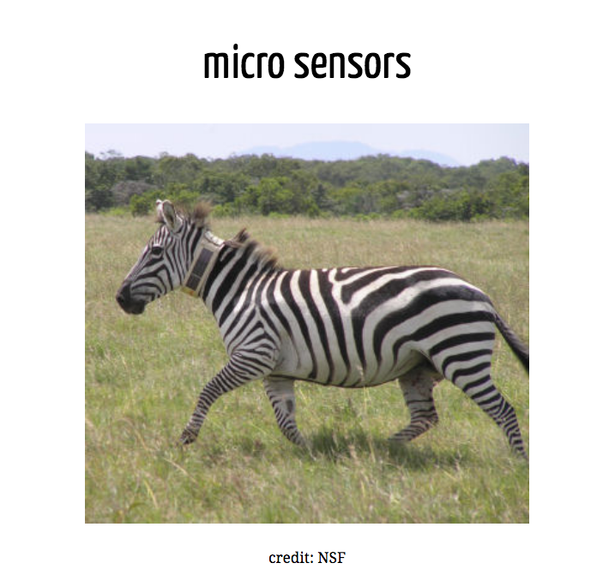

Slide 5
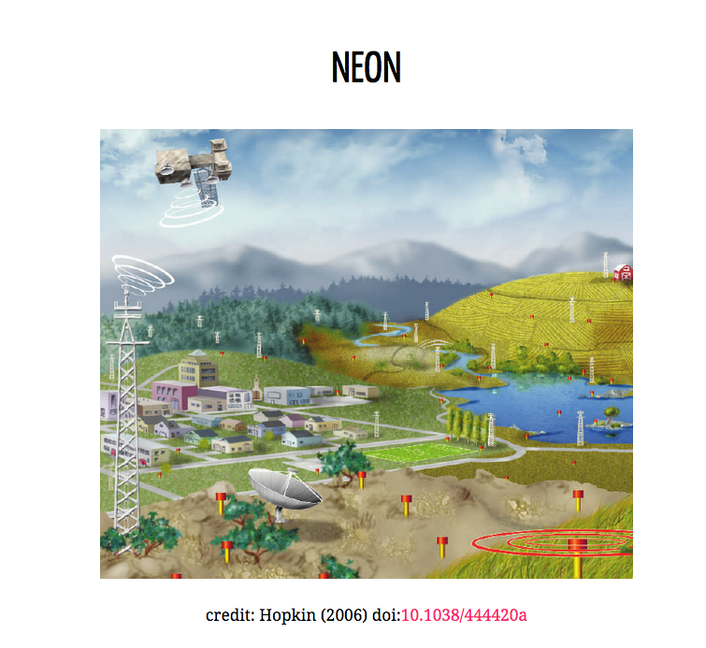

Slide 6
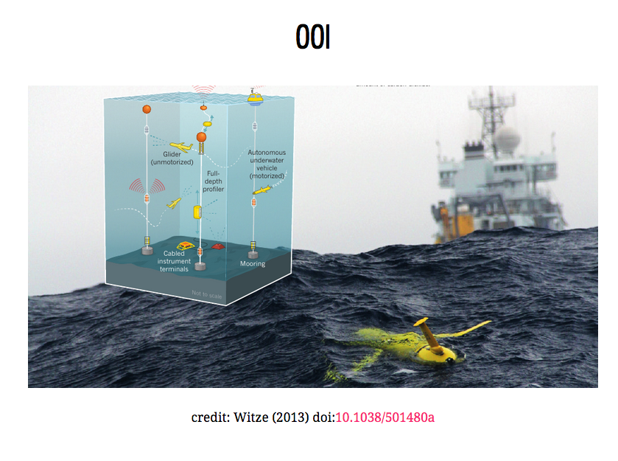

Slide 7
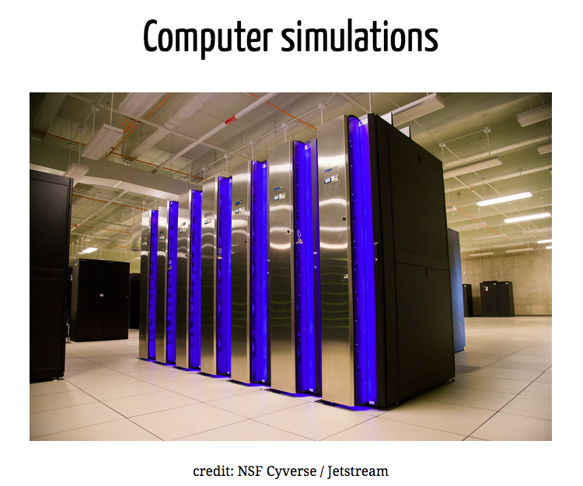

Slide 8
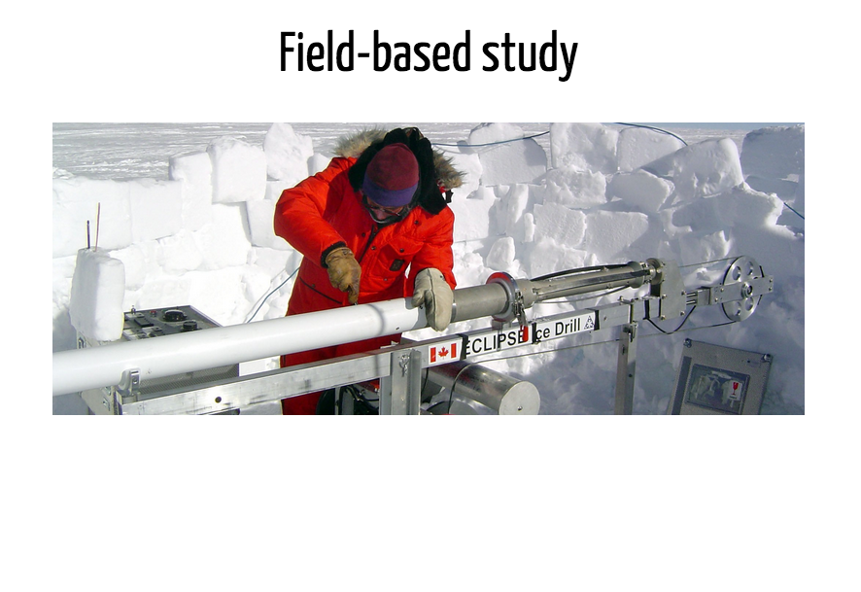

Slide 9
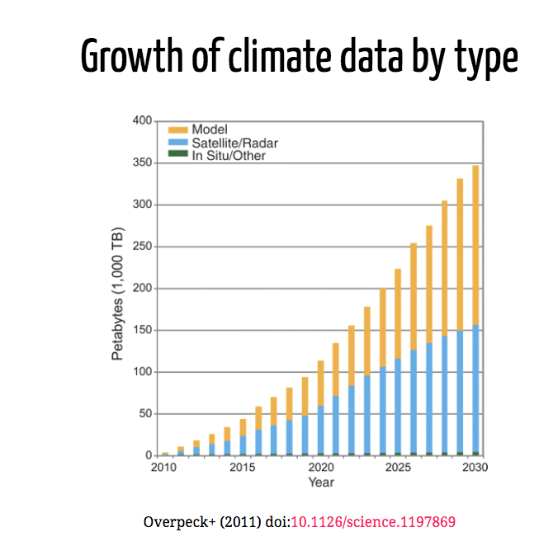

Slide 10
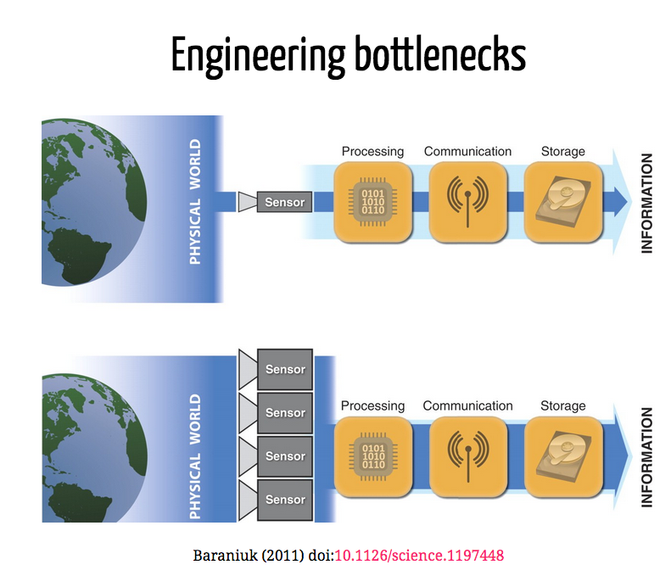

Slide 11
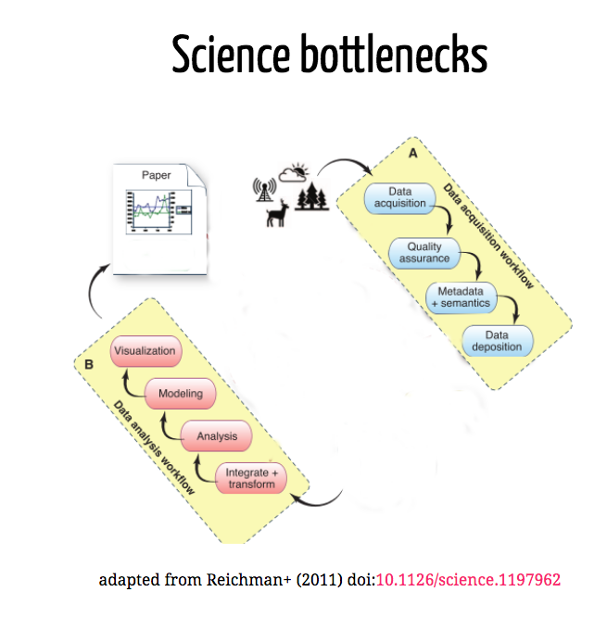

Slide 12
Our focus is on these Science bottlenecks

Slide 13

Course content: data life cycle
Wickham and Grolemund R for Data Science

Slide 14
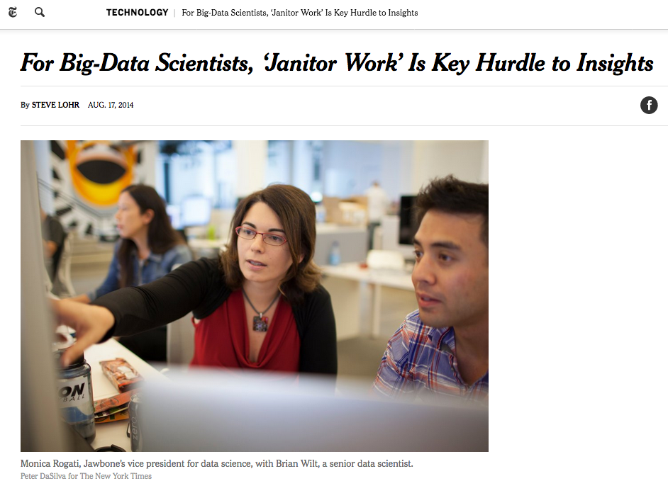
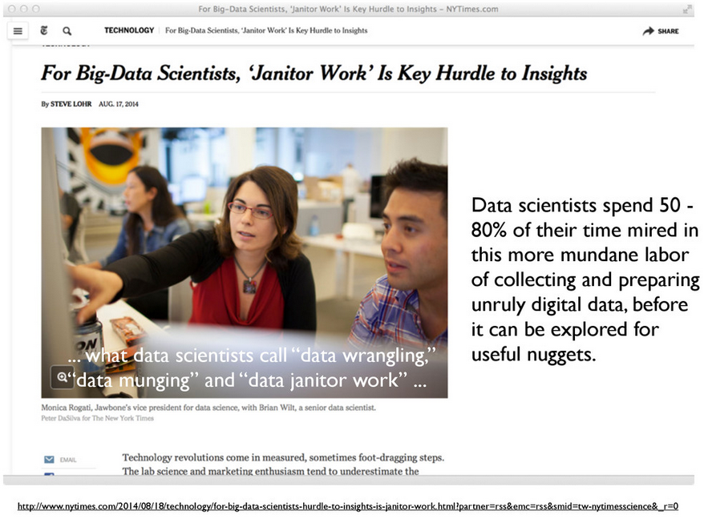
Data cleaning

Slide 15
Analysis and modeling
Formally the 80%
Computational developments have made this much easier
And led to an explosion in new methods and tools

Slide 16
Science bottlenecks

Slide 17
Different ways for data to be “big”
Volume
Variety
Velocity

Slide 18
Volume

Slide 19
Data visualization
Today the visualization component has become a bottleneck
To often visualization becomes only an end-product rather than an exploration tool
A problem because visualization is a quick way to spot errors
Fox & Hendler (2001): doi:10.1126/science.1197654

Slide 20
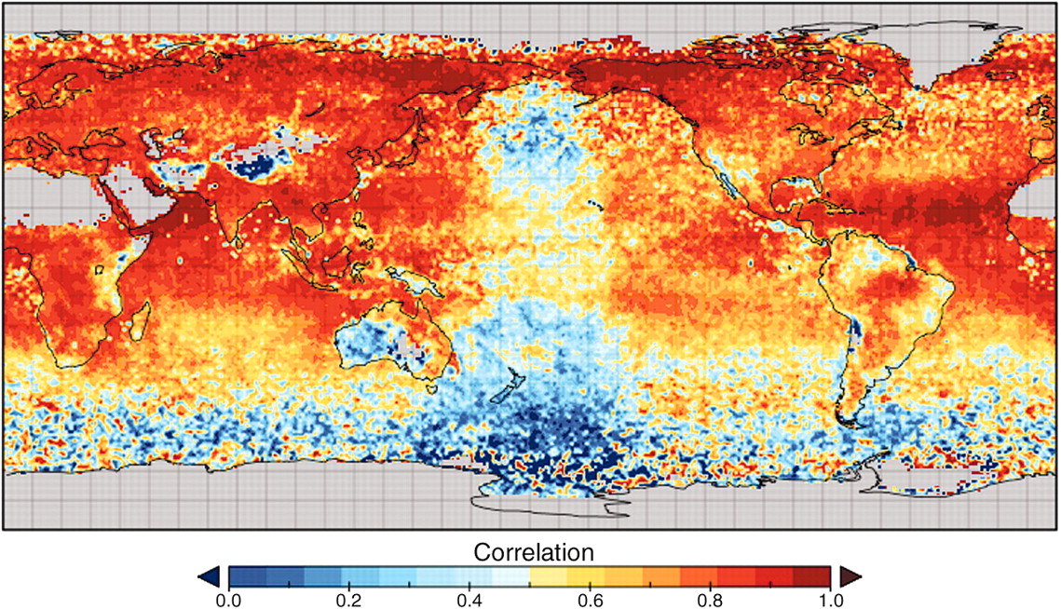
Fox & Hendler (2001): doi:10.1126/science.1197654

Slide 21
Variety

Slide 22
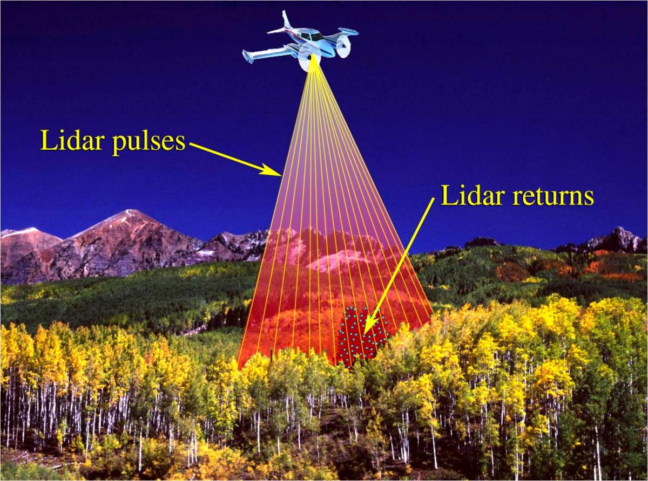

Slide 23
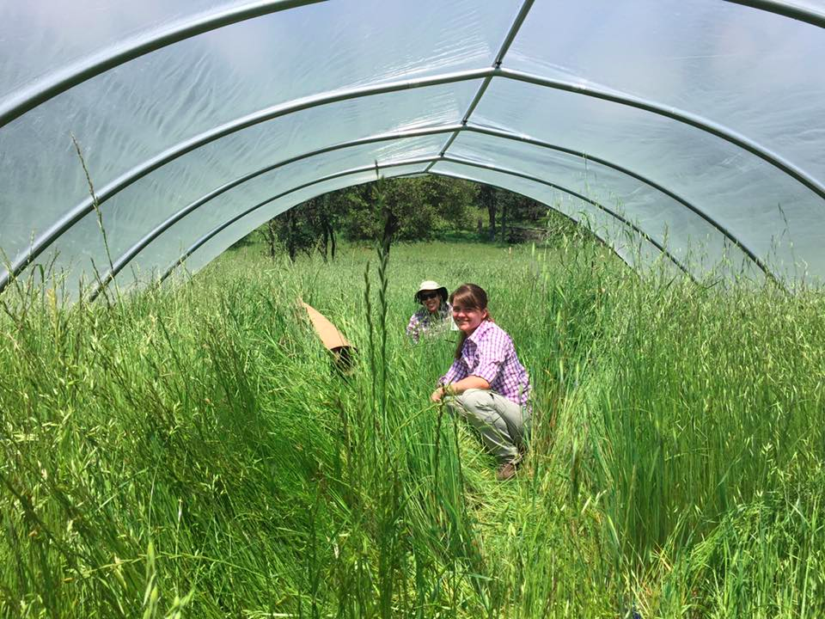

Slide 24

Vertically integrated data repositories

Slide 25
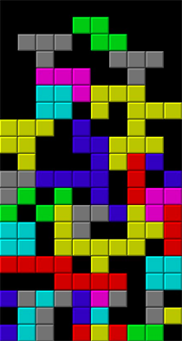
Limits to vertical integration

Slide 26
Velocity

Slide 27
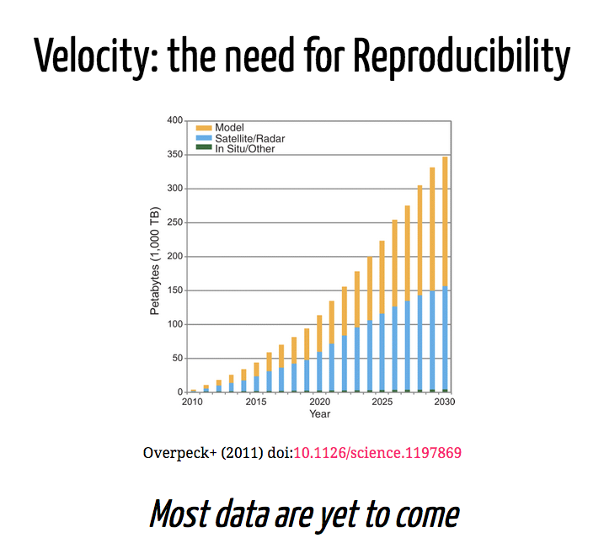

Slide 28
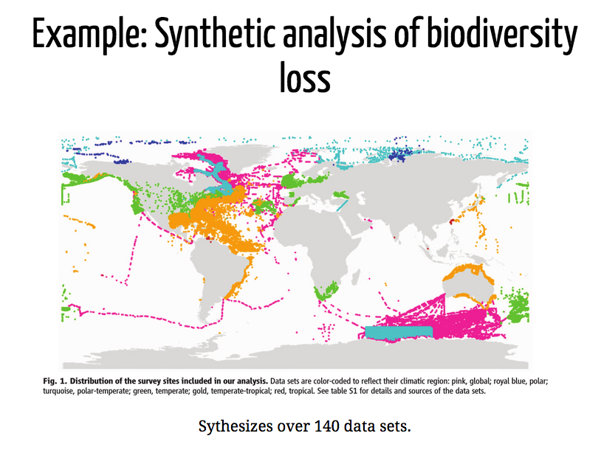

Slide 29
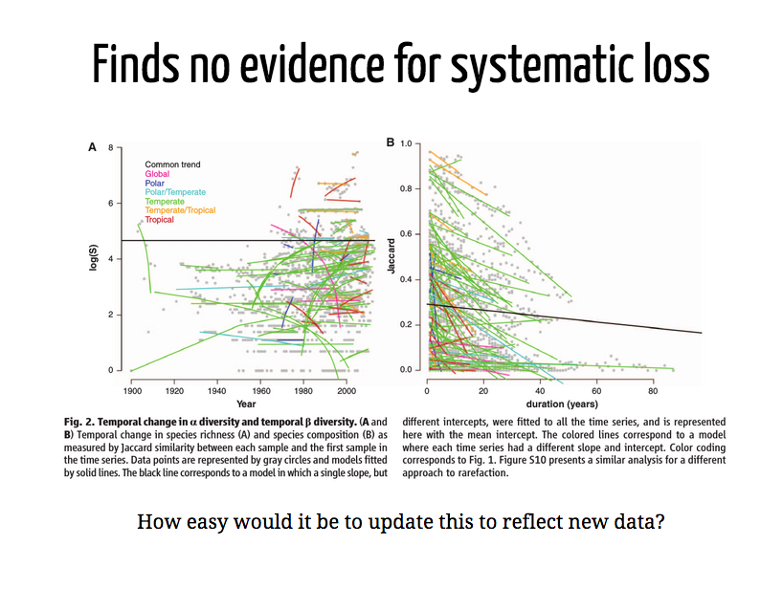

Slide 30
Reproducibility: Important for other reasons as well

Slide 31
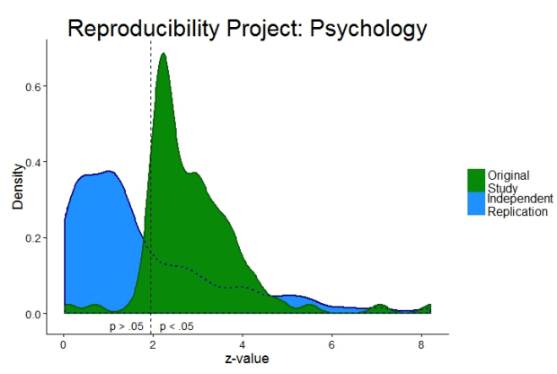

Slide 32
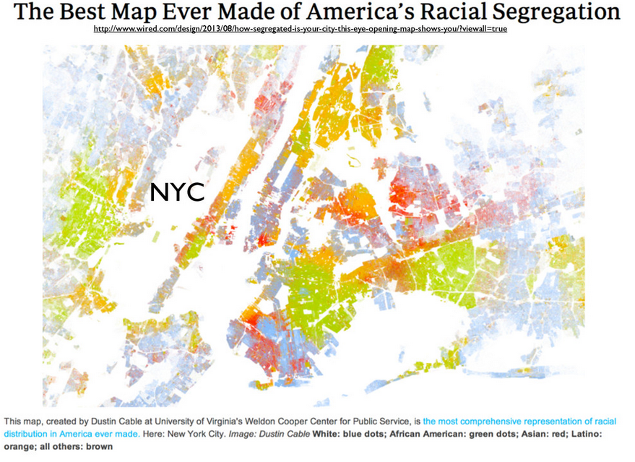

Slide 33
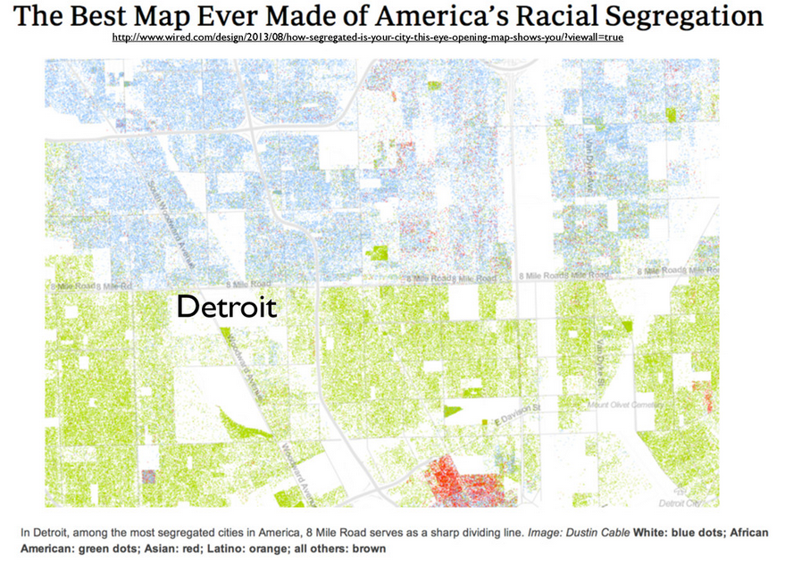

Slide 34
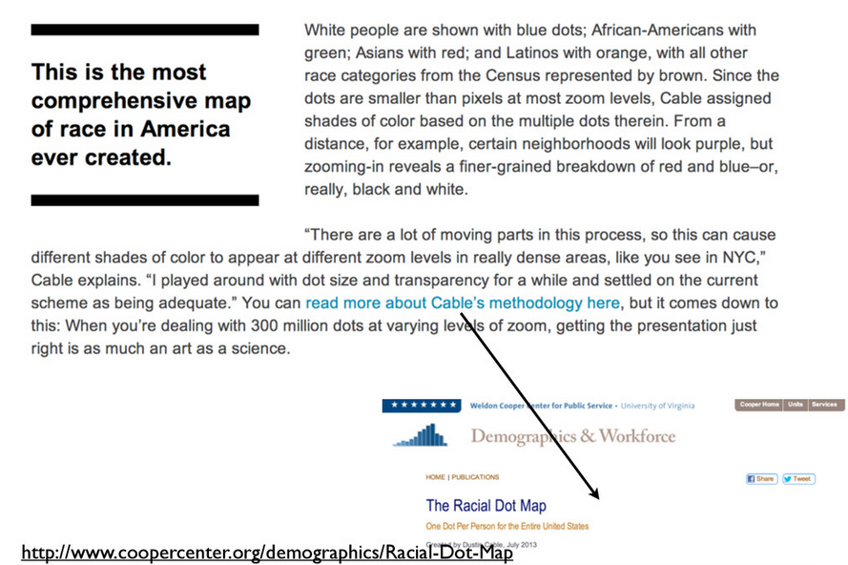

Slide 35
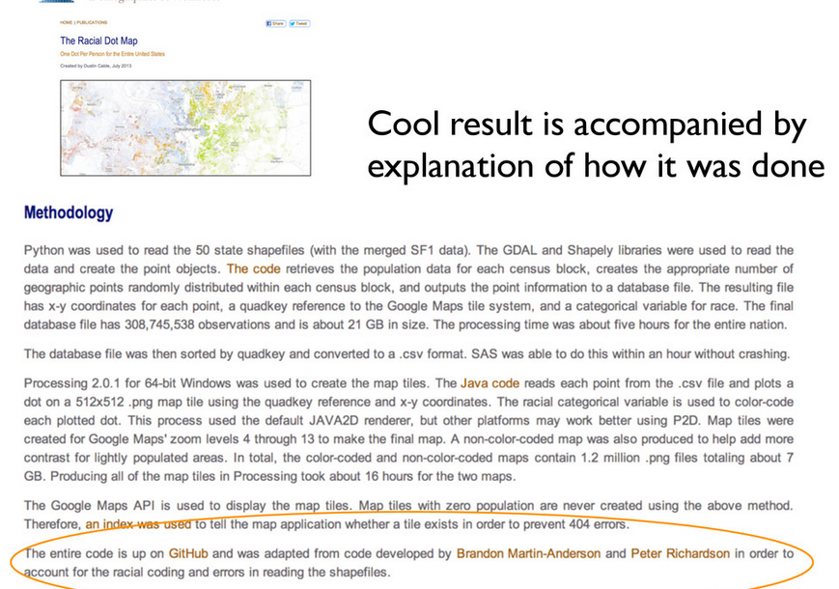

Slide 36
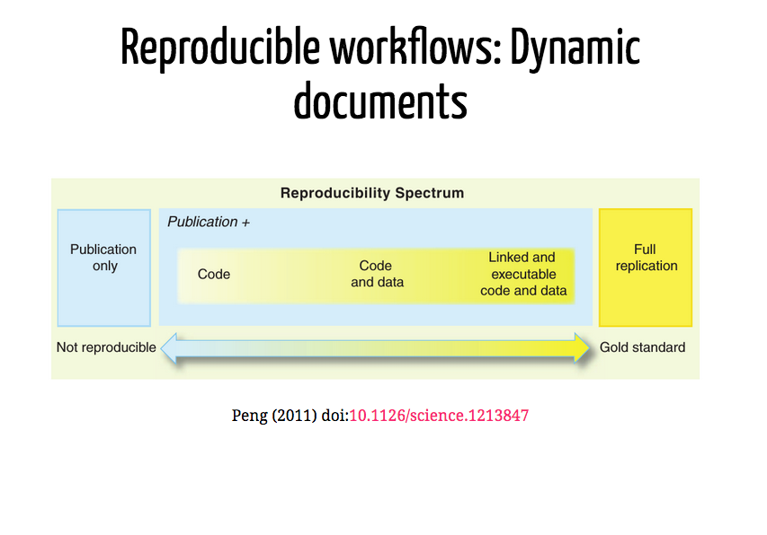

Slide 37
This course:
Real data, real tools
Things will break
Things will change

Slide 38
This course:
Some things will be in keeping with good pedagogy:
We’ll start with graphs first
Active learning
Some things aren’t:
We’ll jump forward and back at times
Starting at the deep end

Slide 39
How we’ll do it:
Different modules in which we transition from learning and coding as a class to independently
Frequent practice via four problem sets
An independent project in which you go from raw data to a reproducible final report
A free online text to help you along! https://r4ds.had.co.nz/

Slide 40
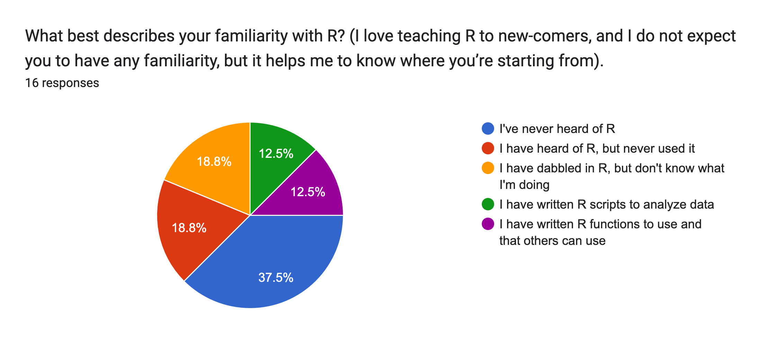
Who we are:
Grad students!
A smattering of what we think about: genetics, evolution, ecology, climate change, molecular biology, neurobiology, microbiota

Slide 41
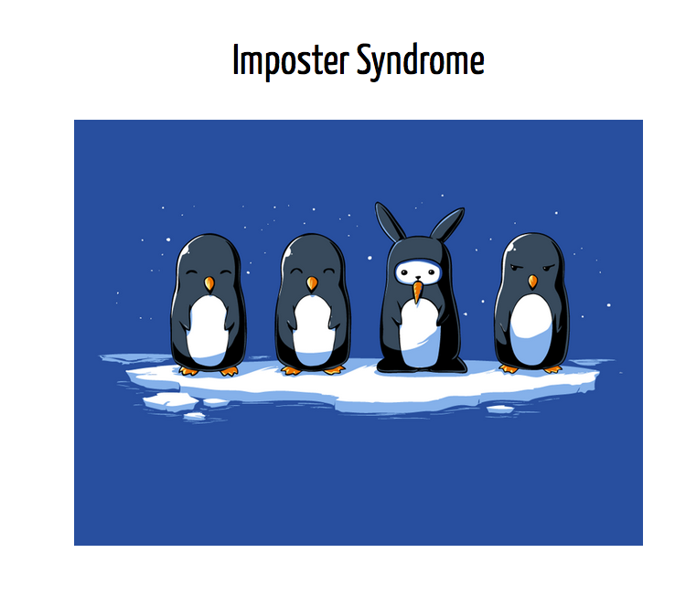

Slide 42
Language: Why R?
Scripted languages allow reproducibility
Not about technical attributes
Pick your language based on what people in your area speak/code
Rstudio, Rmarkdown and other tools for communication and sharing
A great open-source community (on that note - thanks to Carl Boettiger and Jenny Bryan for many of todays slides)

Slide 43
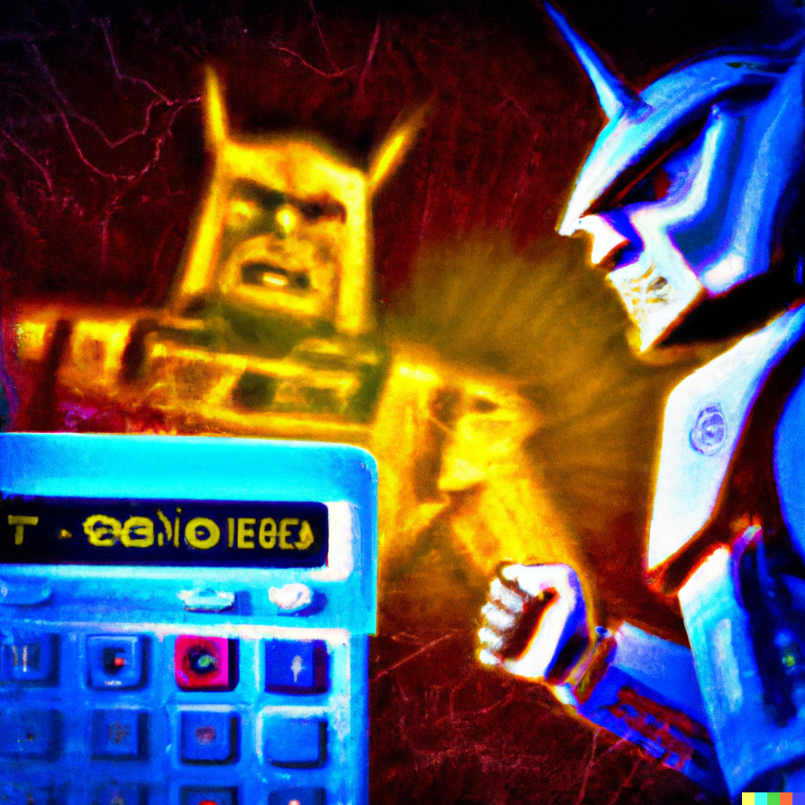
Generative AI and education
Dall-E, 2024-01-03. “digital art reflecting a Western showdown between a calculator and artificial intelligence”. Generated using OpenAI. https://labs.openai.com/

Slide 44
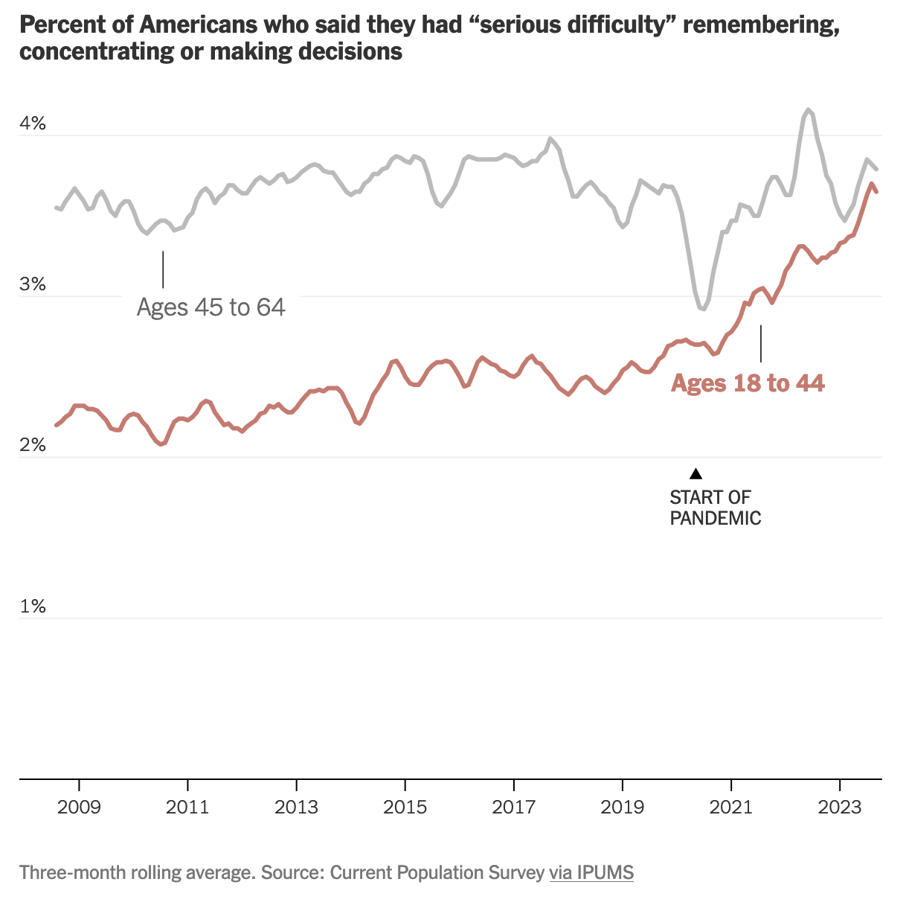
Why the mask?
This is me !!
😧
F. Paris in the NYTimes “The Upshot” 13 Nov 23

Slide 45
Exploratory data analysis exercise
Goals for this exercise:
Highlight the value of plotting our data before we analyze it
Get to know one another
Viscerally appreciate how much easier R will make our lives!

